Slide 1
FUNDAMENTAL OF ALGORITHM
Lecturer: Saroj Poudel
Qualification : M.S CIS&IT
Lincoln University College,

Slide 2


Spanning tree and Minimum Spanning Tree
A spanning tree is a sub-graph of an undirected connected graph, which includes all the vertices of the graph with a minimum possible number of edges.
If a vertex is missed, then it is not a spanning tree.
The edges may or may not have weights assigned to them in spanning tree.

Slide 3
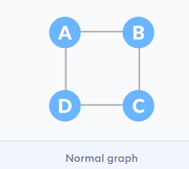
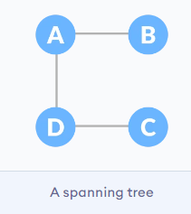
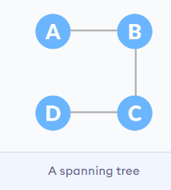
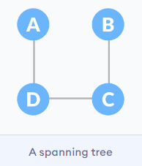
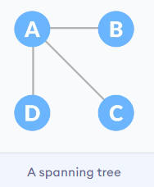
Example of Spanning Tree
Let the original graph be:

Slide 4
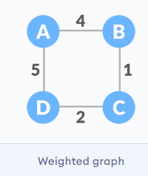
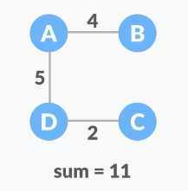
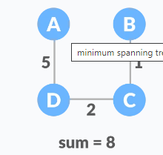
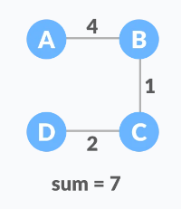
Minimum Spanning Tree
A minimum spanning tree is a spanning tree in which the sum of the weight of the edges is as minimum as possible.
The initial Graph :

Slide 6
Minimum Spanning Tree: Kruskal Algorithm
A minimum spanning tree (MST) or minimum weight spanning tree is a subset of the edges of a connected, edge-weighted undirected graph that connects all the vertices together, without any cycles and with the minimum possible total edge weight. Application in the design of networks, Handwriting recognition, Image segmentation
Kruskal’s Algorithm
Kruskal’s Algorithm builds the spanning tree by adding edges one by one into a growing spanning tree. Kruskal's algorithm follows greedy approach as in each iteration it finds an edge which has least weight and add it to the growing spanning tree.
Algorithm Steps:
Sort the graph edges with respect to their weights.
Start adding edges to the MST from the edge with the smallest weight until the edge of the largest weight.
Only add edges which doesn't form a cycle , edges which connect only disconnected components.

Slide 7
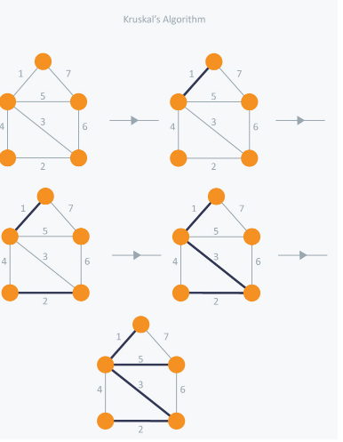

Slide 8
Prim’s Algorithm
Prim's algorithm is a minimum spanning tree algorithm that takes a graph as input and finds the subset of the edges of that graph which”
form a tree that includes every vertex
has the minimum sum of weights among all the trees that can be formed from the graph

Slide 9
Prim’s Algorithm
It falls under a class of algorithms called greedy algorithms that find the local optimum in the hopes of finding a global optimum.
We start from one vertex and keep adding edges with the lowest weight until we reach our goal.
The steps for implementing Prim's algorithm are as follows:
Initialize the minimum spanning tree with a vertex chosen at random.
Find all the edges that connect the tree to new vertices, find the minimum and add it to the tree
Keep repeating step 2 until we get a minimum spanning tree

Slide 10
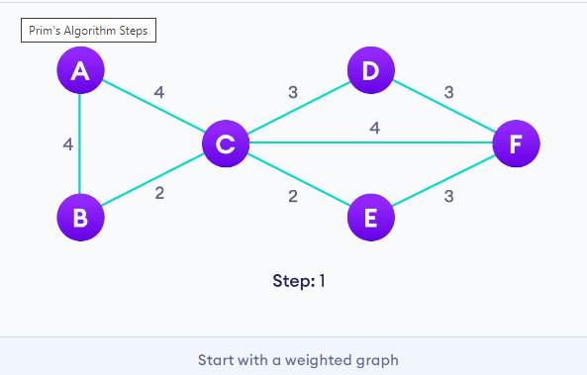
Example of Prim's algorithm

Slide 11
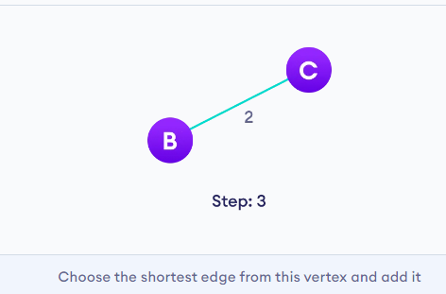
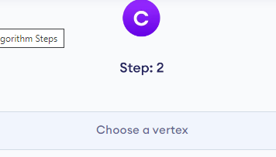
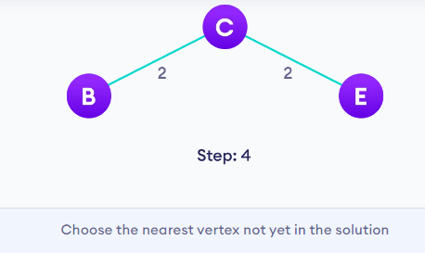
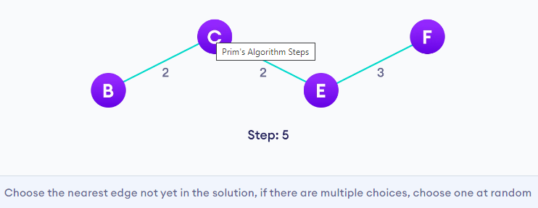

Slide 12
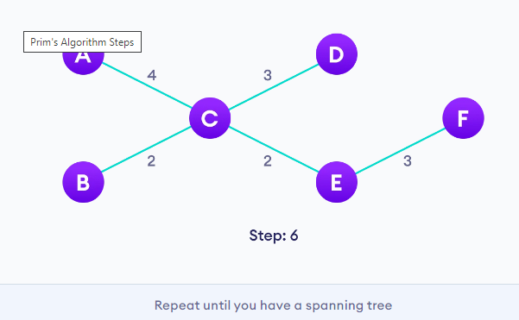

Slide 13
Shortest Path Algorithm: Dijksrtra Algorithm
The shortest path problem is about finding a path between 2 vertices in a graph such that the total sum of the edges weights is minimum.
Dijksrtra Algorithm:
It is a greedy algorithm that solves the single-source shortest path problem for a directed graph G = (V, E) with nonnegative edge weights, i.e., w (u, v) ≥ 0 for each edge (u, v) ∈ E.
Dijkstra's Algorithm maintains a set S of vertices whose final shortest - path weights from the source s have already been determined. That's for all vertices v ∈ S; we have d [v] = δ (s, v). T
set it to zero for our initial node and to infinity for all other nodes. Set the initial node as current
find minimum weight/distance from source to adjacent node that is unvisited repeat process until all node are visited .
Finally display the shortest path from source to destination.

Slide 14
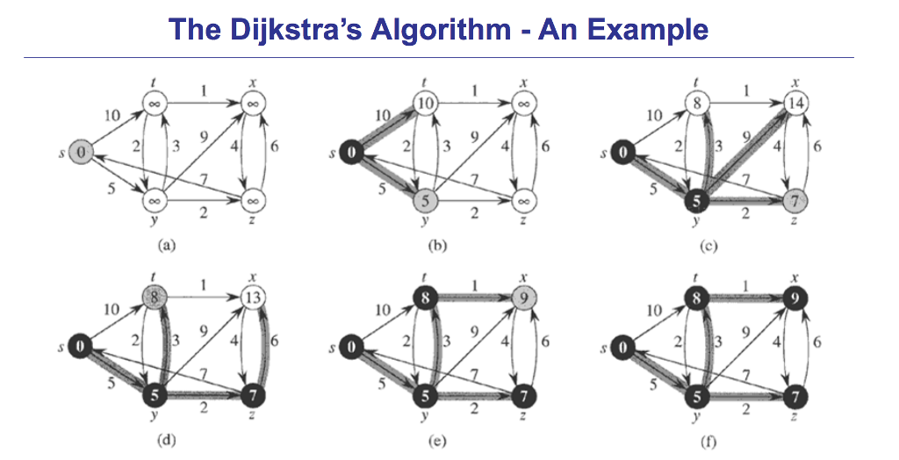

Slide 15
Bellman Ford's Algorithm
Bellman Ford algorithm helps us find the shortest path from a vertex to all other vertices of a weighted graph.
It is similar to Dijkstra's algorithm, but it can work with graphs in which edges can have negative weights.
Negative weight edges might seem useless at first but they can explain a lot of phenomena like cashflow, the heat released/absorbed in a chemical reaction, etc.
Negative weight edges can create negative weight cycles i.e. a cycle that will reduce the total path distance by coming back to the same point.

Slide 16
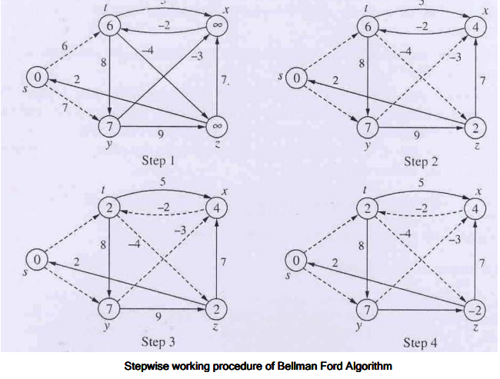

Slide 17
